Slide 1
AAUP Annual APC Training
August 31, 2023
Joel Phillips

Slide 2
APC Training Introduction
Governance is one of the most important rights negotiated between the AAUP and the administration.
Today’s training outlines how APCs meetings will operate as well as your responsibilities as an elected representative.

Slide 3
When you have further questions about Governance…
Ideally, ask any procedural questions before an APC meeting. If during a meeting a question occurs, simply table the item until you clarify it with the AAUP leadership.
Jeff Halpern (halpern@rider.edu)

Slide 4
Face-To-Face Meetings
The CBA defines meetings as face-to-face.
Only if state or University mandates require governance to take place remotely will APCs employ Zoom procedures in order to adhere to the Collective Bargaining Agreement (CBA).

Slide 5
Face-To-Face Meetings
Please keep your APC meeting in its assigned day-and-time slot!

Slide 6
Transparency
The CBA specifies that all APC meetings are open to members of the community.
Meetings may be held on Zoom only if circumstances require it, such as a CDC recommendation. In such case, the APC agenda must include a Zoom link. For improved security, please do not use a personal link and generate a new code for each meeting.

Slide 7
Transparency
If a meeting occurs over Zoom, APC members must maintain a live video feed and identify themselves by their Rider University employee name (i.e., no “handles”).

Slide 8
Documents
All documents must be electronic.
Minutes must still be approved face-to-face at the beginning of the meeting, whether in person or via Zoom.

Slide 9
Documents
Only to those documents that were posted to the AGP at least three days prior to the onset of the meeting may be shared or referenced during the APC meeting.

Slide 10
Voting
Voting may be via a show of hands, acclamation, or by secret ballot on request of any member.
No Zoom? Click the box. Zoom? Use the right arrow.

Slide 11
Voting (Zoom secret ballot)
Only if we are required to use Zoom can you use a Zoom poll for a secret ballot. Zoom provides instructions for how to create polls. Chairs should create a generic poll in advance of any meeting during which a vote might occur.
E.g., I am in favor of the motion Yes No Abstain.
Be sure to select the ‘Anonymous’ check box.

Slide 12
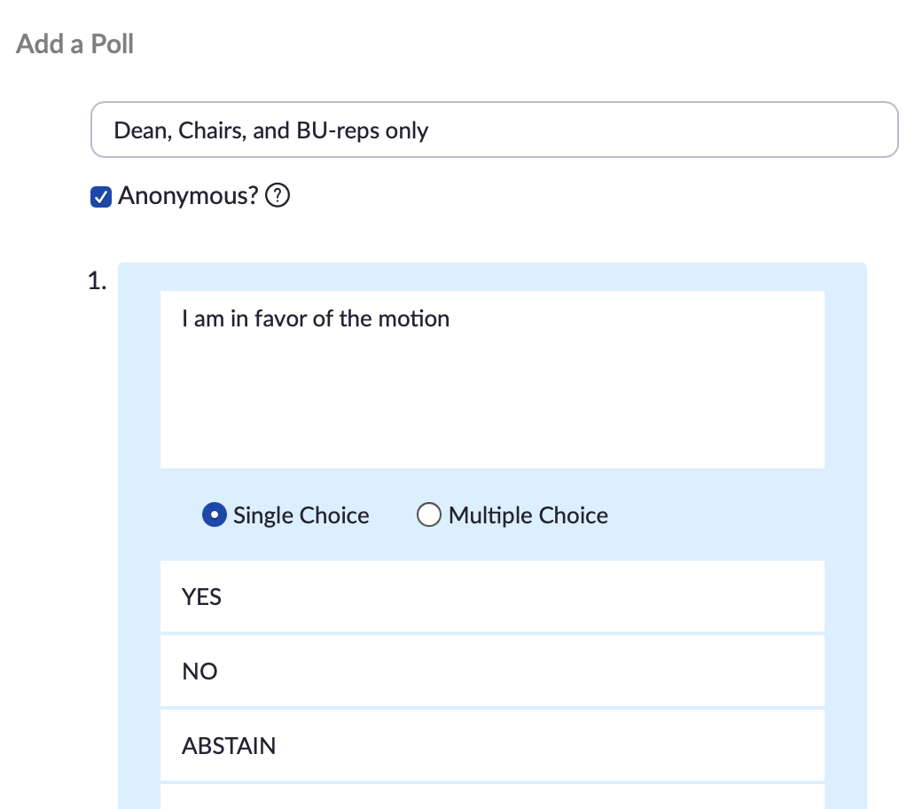
Voting

Slide 13
Visitors
All members of the Rider community are welcome to attend APC meetings.
No Zoom? Click the box. Zoom? Use the right arrow.

Slide 14
Visitors (Zoom-meeting protocols)
At all times visitors must identify themselves using their Rider University employee name (i.e., no “handles”).
The Chair may remove any anonymous or unrecognized individuals from the meeting.

Slide 15
Visitors (Zoom-meeting protocols)
Visitors must remain silent/muted and if on Zoom, are not required to stream their video.
However, if the Chair permits visitors to speak via Zoom, they must turn on their livestream video and unmute.

Slide 16
Visitors (Zoom-meeting protocols)
Unless the Chair invites visitors to use the chat feature, visitors should refrain from doing so.
Exception: Asking the Chair for recognition to speak.

Slide 17
Recommendations
Leave mics open only on the Chair, Vice Chair, and any chair-recognized speaker.

Slide 18
Recommendations
APCs can decide whether or not to permit Zoom backgrounds, but if allowed, backgrounds shouldn’t detract from committee’s ability to conduct its business.

Slide 19
Recommendations for Using Chat
APCs are not required to use the chat feature, but if you choose to, limit the chat to official committee business while the meeting proper is in session.

Slide 20
Recommendations for Using Chat
The Vice-Chair/Secretary might monitor the chat to alert the Chair someone wishes to address the committee.

Slide 21
Recommendations for Using Chat
Portions of the chat relevant to the committee’s business should be incorporated into the minutes.

Slide 22
APC-Specific Zoom Procedures
If your APC augments these Zoom-related procedures, please make certain any addition adheres to the CBA. Moreover, please publish the procedures so members of your college and the community will know them in advance of a meeting.

Slide 23
APC Responsibilities
Article XIII outlines APC procedures in detail. What follows is an overview.

Slide 24
What do APCs do?
APCs make academic policy.

Slide 25
What is a policy?
A policy is anything passed by an APC that can be implemented (e.g., course approvals, curriculum changes, creation of subcommittees and assigning of their charges, admissions requirements, etc.)

Slide 26
APC vs. Senate: What’s the difference?
Most institutions have a Faculty Senate, a body that makes recommendations to administrators in whose hands final decisions are made— “shared” governance in name only.

Slide 27
APC vs. Senate: What’s the difference?
Our members vote to make policy.
Thus our process is authentic shared governance.

Slide 28
APC vs. Senate: What’s the difference?
Though administrators have a slight majority on all APCs no policy can pass without support from both parties.
Elected members of the faculty chair our APCs, set their agendas, and run the meetings.

Slide 29
College APC Committee Membership
3 elected bargaining-unit members
Dean
3 dean-appointed administrators
1 representative selected by SGA

Slide 30
CBA 2022 ff. College of A and S = 2 APCs
Westminster Choir College and the School of Communication, Media and Performing Arts
School of Humanities and Social Sciences and School of Science, Technology, and Mathematics

Slide 31
CBA 2022 ff. Other College APCs
College of Education and Human Services
Brodsky College of Business
Library

Slide 32
CBA 2022 ff. UAPC
UAPC shall consist of thirteen (13) voting persons as follows.
6 bargaining-unit members, comprising one member selected by the faculty members of each APC and the LAPC, from among the college/school/library faculty they represent, and one member from among the continuing education faculty charged with representing continuing education programs and policies
7 members of the University Administration, to be selected by the Provost

Slide 33
Eliminations/Additions and APCs
During this contract, if there are eliminations or additions that would affect APC balance, the contract outlines a method to retain the voting balance between bargaining-unit faculty and administration.

Slide 34
Electing APC Officers
From among the full-time bargaining unit members each APC shall elect a Chair and a Secretary/Vice Chair.

Slide 35
Electing APC Officers
This has been a long-time practice:
Prior to the first meeting of the entire APC its bargaining-unit members caucus and select the officers and liaisons.

Slide 36
Responsibilities of the APC Chair
The (daunting) list of responsibilities that follows does not mean that Chairs themselves must do these things. Rather, Chairs must see that these things are done.

Slide 37
Responsibilities of the APC Chair
Immediately after APC elections, provide Terri Rue (aaup@rider.edu) and the Provost’s office the names and titles of all elected officers.

Slide 38
Responsibilities of the APC Chair
Your APC’s meeting schedule is set per the Agreement by the AAUP president and chair of the UAPC.
Post it to the AGP as soon as possible.

Slide 39
Responsibilities of the APC Chair
Publish a call for agenda items and a deadline for their submission.
From the submitted items, set your APC’s meeting agenda on a first-in, first-on basis.
The committee may vote to alter the agenda.

Slide 40
Responsibilities of the APC Chair
Email the agenda to the entire AGP.
Post your agenda to your committee’s AGP site in no case less than three days prior to the meeting. More notice is desirable.

Slide 41
Responsibilities of the APC Chair
Invite guests when matters pertain to the expertise or interests of the guests.

Slide 42
Responsibilities of the APC Chair
Run meetings in an orderly manner, in accordance with the procedures specified in the Agreement.

Slide 43
Responsibilities of the APC Chair
Where the Agreement is silent, procedures may be established by majority vote of APC committee members, but the practice has been to follow Robert’s Rules of Order.
Contractual procedures can only be altered by the AAUP and administration and never by an APC vote.

Slide 44
Responsibilities of the APC Chair
Schedule the annual all-faculty forum to solicit feedback from colleagues regarding agenda to be pursued by the APC in the future.

Slide 45
Responsibilities of the APC Chair
Request information necessary for the committee to deliberate.
For example, the administration is required to provide relevant information, including financial, at the request of the APC.

Slide 46
Responsibilities of the APC Chair
Distribute the approved minutes to the entire AGP and post them to the AGP.

Slide 47
Responsibilities of the APC Chair
Recruit faculty to serve on various committees.

Slide 48
Responsibilities of the APC Chair
Help proposers navigate the procedures your APC has devised for proposal submission.

Slide 49
Responsibilities of the APC Chair
Run your College’s P&T elections.
The AAUP runs the elections for bargaining-unit members who serve on APCs.

Slide 50
Responsibilities of the APC Chair
Ensure all newly passed and revised courses are submitted to the Registrar in the required format.

Slide 51
Responsibilities of the APC Chair
Keep your committee’s AGP site up to date.

Slide 52
Responsibilities of the Secretary/Vice Chair
Serve as Chair if the Chair cannot attend a particular meeting.

Slide 53
Responsibilities of the Secretary/Vice Chair
Take minutes at each meeting and transmit them to the Chair shortly thereafter.

Slide 54
Responsibilities of the Secretary/Vice Chair
Assist the Chair in editing and distributing APC documents as well as with committee business.

Slide 55
Role of Regular and Alternate Members
APC members represent all the faculty of their College, not just their own departments.

Slide 56
Role of Regular and Alternate Members
Reach out to all colleagues in their College in order to best serve their interests.

Slide 57
Role of Regular and Alternate Members
Come prepared to each APC meeting and ask tough questions of every proposal.

Slide 58
Role of Alternate Members
Alternate members may attend and participate in all meetings.
Alternates may vote if a regular member cannot attend.

Slide 59
UAPC Reps ←→ College/School APCs
College/School representatives who sit on the UAPC should inform their College/School APC of the work of the other and soliciting feedback from colleagues to enhance deliberations.

Slide 60
Meetings
The AAUP publishes a calendar of annual meeting dates for all APCs and the UAPC. Though some APCs choose a different schedule, each APC must post their meeting schedule on the AGP.

Slide 61
Meetings
Meetings are scheduled from September through May.
Meetings may be held during summer (1) at the request of a majority of the committee and (2) as long as a quorum is present.

Slide 62
Role of Visitors
Only elected/appointed APC members or invited to presenters have the privilege of the floor.
All others are there as observers, not participants, in the debate.

Slide 63
Role of Visitors
Per Robert’s Rules of Order, the committee may vote to give the floor for comment to any visitor, but debate is limited to the members of the committee.

Slide 64
Minutes
The Secretary/Vice Chair takes minutes at each meeting and provides them to the Chair for review shortly after the meeting.

Slide 65
Minutes
Minutes contain only a record of those present, a summary of the items discussed, and the actions taken, if any.
Each summary comprises a brief recital of the substance of the discussion.

Slide 66
Minutes
In their draft form, minutes are uploaded to the committee’s AGP site.

Slide 67
Minutes
Minutes are normally approved during the APC’s next face-to-face meeting.

Slide 68
Minutes
Approved minutes are distributed to all members of the AGP and posted to the committee’s site.
Once emailed, approved minutes begin a 28-day clock for review by the other APCs.

Slide 69
Voting
Each APC member has one vote equal to that of all other voting members.
The SGA rep is by contract a non-voting member.

Slide 70
Voting
No one has the power to veto any item or to make any special requirements or conditions that restrict the operation of the APC to carry out its business under the Agreement.

Slide 71
Voting
A policy may be brought to a vote regarding its enactment by a vote of at least four APC members, including the Dean.

Slide 72
Voting
In general, votes should not occur until a supermajority (majority plus one) agrees that a proposed policy has been sufficiently discussed.

Slide 73
Voting
Article XIII includes a detailed discussion of rules on passing a policy and on curtailing debate.

Slide 74
Voting
On request of any committee member, voting can occur by secret ballot.

Slide 75
APC Review of ALL Passed Policies
APCs must review the actions of other APCs to determine whether any newly passed policies conflict with policies already in existence or that create an undesirable/unforeseen impact.

Slide 76
APC Review of ALL Passed Policies
If APC1 determines that APC2’s passed policy will have a substantial adverse impact, APC1 submits an impact statement to APC2.
The two APCs meet to resolve the problem.
If the APCs cannot agree, the UAPC serves as a mediator.

Slide 77
Proposals: Resource Impact Statements (RIS)
Each proposal coming before the APC must be accompanied by a Resource Impact Statement (RIS).
Yes, that includes a proposal for a single new course.

Slide 78
Proposals: Resource Impact Statements (RIS)
Why do we require the RIS?
Decisions regarding whether a proposal becomes policy are made by the APC, which will weigh whether the benefit of the proposed policy justifies the resource costs of its implementation.

Slide 79
Proposals: Resource Impact Statements (RIS)
Developing the RIS is a joint responsibility of the policy proposer(s) and
The Provost’s office (for UAPC proposals)
The relevant Dean’s office (for College APC proposals)

Slide 80
Proposals: Resource Impact Statements (RIS)
From the time a proposal is first put forward by the proposer(s), the Deans/Provost shall have a specified minimum time to develop the RIS.
Two weeks (minor proposals)
56 days (major proposals)

Slide 81
Proposals: Resource Impact Statements (RIS)
The Dean or Provost cannot refuse to complete an RIS or unduly delay preparation of the RIS because s/he does not support a proposal.

Slide 82
Proposals: Resource Impact Statements (RIS)
Major proposals must also be reviewed by the Facilities Monitoring Committee (FMC) for their space impacts prior to coming to the APC for review. The FMC’s evaluation of the space impact of a major proposal should be incorporated into the RIS.

Slide 83
Who May Bring a Proposal?
Typically departments bring proposals to the APC, having recorded their majority-approval in the minutes of a meeting. It is customary for the APC to invite department members to the APC meeting during which its proposal will be discussed.

Slide 84
Who May Bring a Proposal?
In addition, any member of the Rider community may bring a policy or issue to the attention of the appropriate APC for consideration. It is up to the APC to decide whether the policy or issue will be considered.

Slide 85
Minor Proposals
Minor proposals are items perceived to have a modest impact.
Examples of minor proposals:
A single new course
Committee appointments

Slide 86
Minor Proposals
Informed by but not limited to the preceding guideline, the APC chair will determine whether a proposal meets the criteria for “minor.”

Slide 87
Minor Proposals
Typically, minor proposals require no review by the Facilities Monitoring Committee.
However, FMC review may be requested by the relevant Dean, the Provost, or the AAUP.

Slide 88
Major Proposals
Major proposals are items perceived to have a reletively substantial impact, such as new majors, new minors, new programs, new departments, and the like.
Historically, ALL proposals were what are now called major proposals.

Slide 89
Major Proposals
Major proposals require review by the Facilities Monitoring Committee.

Slide 90
Major Proposals
Informed by but not limited to the preceding guideline, the APC chair will determine whether a proposal meets the criteria for “major.”

Slide 91
APC Procedural Clocks
APC procedural clocks are day-counters initiated by certain events that occur during the governance process. They run only during fall and spring semesters and exclude the periods of winter break and summer.

Slide 92
APC Procedural Clocks
Because academic decisions have University-wide impact, procedural clocks help ensure that all community members are informed of potential changes and have the opportunity to participate in the deliberative process.

Slide 93
Procedural Timeline: Overview
Let’s review quickly the process for what may happen before, during, and after APC meetings.

Slide 94
Procedural Timeline: Prior to an APC meeting
More than 1–2 months:
The proposer develops a proposal.

Slide 95
Procedural Timeline: Prior to an APC meeting
Minus circa 1–2 months:
The proposer works with the Dean or Provost to develop a Resource-Impact Statement (RIS) that must accompany the proposal.

Slide 96
Procedural Timeline: Prior to an APC meeting
Minus circa 1–2 weeks:
The proposer submits a proposal and all supporting documentation including the RIS to the APC Chair by the deadline for submissions set by each APC—typically one to two weeks prior to a meeting.

Slide 97
Procedural Timeline: Prior to an APC meeting
Minus circa 3–5 days at a minimum:
The APC Chair uploads the proposal and all supporting documentation including the RIS to the AGP.

Slide 98
Procedural Timeline: Prior to an APC meeting
Minus circa 3–5 days at a minimum:
The APC agenda is published to the entire University community and posted on the Academic Governance Portal (AGP).

Slide 99
Procedural Timeline: During an APC meeting
Major proposals that have been deliberated during APC meetings for at least 56 days may be voted on.
The first meeting during which a major proposal appears initiates a procedural clock of not less than 56 days.

Slide 100
Procedural Timeline: During an APC meeting
Minor proposals—if complete, including the RIS—may be introduced, discussed, and voted on.

Slide 101
Procedural Timeline: After a policy passes
Plus 28 days:
The receipt of an APC’s approved minutes initiates a 28-day clock during which the policy is reviewed by all other APCs to determine whether there will be a substantial adverse impact if the policy were implemented.

Slide 102
Procedural Timeline: After a policy passes
Plus 29 days:
If there were no review-period objections, two things may occur.
The admin will implement the policy (typical).
The admin notifies the APC and AAUP that it will not implement the policy (rare).

Slide 103
Procedural Timeline: After a policy passes
Within 56 days:
If the admin declines to implement a policy duly passed under Article XIII or chooses to implement a rejected policy, they must provide a written rationale to the APC and AAUP within 56 days of the date the policy was passed.

Slide 104
Procedural Timeline: After a policy passes
Reasons for Admin rejection of policy:
The reasons for rejecting a duly passed policy are very contstrained. If your APC policy is rejected by the admin, please contact the AAUP immediately for guidance.

Slide 105
Thanks for your kind attention during this abuse of your goodwill, knowing it is for a good cause.
Any questions now?
Later? Email Jeff.

